Slide 1
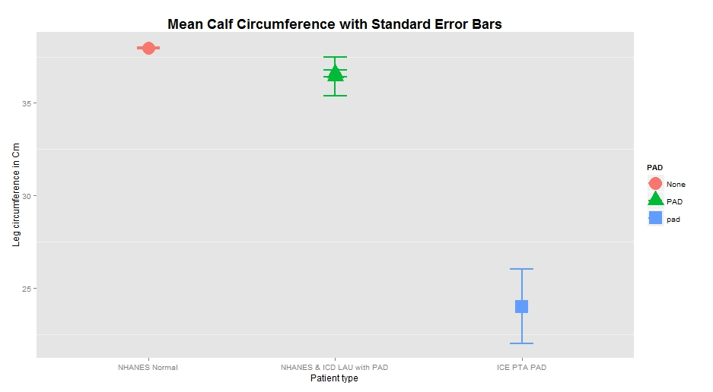
Quantification of Soft Tissue Loss Among Patients With Peripheral Arterial Disease
Abbas S Ali, Taha Baig, Muhammad Sadique, Mohammed Ali, Asad U Qamar
ICE
Introduction
NHANES Overview
What is it? The National Health and Nutrition Examination Survey (NHANES) is a database with statistics of studies outlined to assess the health and nutritional status of everybody ranging from young kids to old adults in the United States. With the combination of interviews and physical examinations these surveys compile the database of NHANES. The interview component focuses on demographic, socioeconomic, dietary and health-related questions, while the examination portion focuses on medical, dental, and physiological measurements along with lab tests.
Measurement of Calf Width
Calf measurement with tape: Among available patients for calf measurement with tape NHANES method obtained from page 26 of the NHANES biological measurement manual was used to measure maximal calf circumference. In contrast to NHANES for ICE patients measurements for both calves were undertaken. Data in this analysis are presented for thinner calves for PAD and thicker calves for normals.
Calf measurement from X-ray for PTA patients: Tissue width was measured using the image j software from the first frame in the angiogram run wherein both sides of soft tissue were visible. In the angiogram, the frame in which the calibration catheter was available was used. Calf circumference was calculated in cm.
X-ray measurement in control group patients: A control group of cath lab workers had measurements with both x-ray and tape methods. Both x-ray and tape measurements were compared to assess accuracy of x-ray method.
Clinical Data: Trained chart reviewers abstracted data from a data collection tool in patient charts. The following clinical characteristics age, gender, body mass index (BMI), ethnicity, smoking, hypertension, diabetes, and lipid disorder were analyzed.
Results
Peripheral Arterial Disease (PAD) has a prevalence of 4.5% among adults older than 40 in the US population. This rises steeply with increasing age. Loprinzi et al have shown a 23% decrease in accelerometer measured physical activity amongst those with PAD which might contribute to disuse atrophy. Presence of PAD is associated with poor quality of life, amputation and increased cardiovascular mortality. A San Diego population based study showed a progressive increase in 10 year mortality for those without PAD (15%) to those with asymptomatic PAD (45%) to those with severe symptomatic PAD (75%). Furthermore, PAD is under-diagnosed, with a study of 7000 primary care patients, showing PAD in 29% of subjects, with over half of them previously undiagnosed.
WHO has established 33-35 cm as a normal calf circumference for the healthy elderly. Calf circumference has been used as a measure of calf muscle atrophy by Rolland et al. PAD leads to calf muscular atrophy presumably secondary to poor blood supply, and diminished mobility and calf muscle use due to claudication. Our hypothesis was that our population of PAD patients will have significantly reduced calf measurements compared to the general population when controlled for demographics and risk factors.
NHANES Data (n=9145)
ICE LAU data (n=600)
Calf circumference among normal and PAD patients
Prevalence of PAD
Data from available population based studies report the prevalence of PAD from 3.6 to 5 percent. This is similar to the pooled data analyzed from the NHANES cohort for the current paper. ICE has a much greater prevalence (59.2%).
Implications of measurement of calf circumference
For Patients at risk for PAD: Amongst patients who present to the doctors office for routine assessment if calf circumference width were to be measured as a part of physical examination using 36.5 cm as a cutoff to help identify PAD patients. These patients could then undergo a more careful assessment for PAD.
For Patients with typical or atypical symptoms of PAD: Calf circumference of 37 cm amongst those presenting for LAU identifies a cohort likely to have PAD. Thus the technician should more carefully assess such patients.
For Patients presenting for PTA: In these patients calf circumference is evidence for macroscopic tissue loss. The 48 patients identified for our study were a group selected by payors to assess appropriate care. In this cohort data analysis clearly shows evident macroscopic tissue loss. According to guidelines. gov tissue loss is a clear cut indication for PTA amongst PAD patients. Patients who present for PTA to ICE; a referral center serving 10 counties are the sickest ones, evidenced by macroscopic tissue loss.
Analysis of Cohorts
Cohort one (PTA patients): Among 48 patients who were included in the study at ICE, the calculated circumference of the lower extremity was significantly smaller than calculated circumference in normal volunteers. Results came comparably close with tape measurements and x-ray tests amongst the normal volunteers on linear regression.
Cohort two (LAU patients): Calf circumference measured using tape amongst consecutive patients who presented for LAU at ICE showed significant tissue loss among PAD patients compared to Normals.
Cohort three (NHANES 2003-2004 dataset): NHANES data on 9145 patients was processed using R studio. Right Calf circumference for patients with and without PAD was available for the NHANES patients.
ABI | Number of patients
<0.9 (PAD) | 422 (4.6%)
0.9-1.3 (Normal) | 6391 (69.9%)
>1.3 (Non-compliant vessels, excluded from analysis) | 390 (4.3%)
No ABI data (excluded from analysis) | 1942 (21.2%)
Method
Discussion
PAD status based on LAU | Number of patients
No PAD | 245 (40.8%)
Bilateral | 199 (33.2%)
Unilateral (patients excluded from analysis) | 156 (26%)
Cohort Groups
Study | Participants | PAD %
Framingham Offspring Study | n=3313 | 3.6%
NHANES 1999-2002 | n=4895 | 5%
MESA | n=6570 | 3.7%
NHANES (1999-2004) current analysis | n=9145 | 4.6%
ICE LAU cohort | n=600 | 59.2%
Cohort One: PTA Patients Of the patients who presented for Angioplasty of the peripheral vessels (PTA) at the Institute for Cardiovascular Excellence (ICE) in 2012, 48 were selected to measure calf circumference on x-ray.
Cohort Two: LAU Patients All patients who presented to ICE for assessment of leg discomfort and were referred to the ultrasound lab for a lower extremity ultrasound (LAU) from Dec 25 2014 were included. These 600 patients had their calves measured using tape (NHANES method). Using ultrasound data these patients were classified as None (No PAD), bilateral PAD or unilateral PAD (excluded from analysis).
Cohort Three: NHANES Dataset NHANES examines a nationally representative sample of about 5,000 persons each year.
Patients from NHANES (1999-2004) have available ABI. NHANES patients were classified as PAD if ABI in the worse leg <=0.9, Normal if ABI between 1-1.3 and Stiff if ABI >=1.3 (excluded from analysis).
Cohort | PAD | Normal | p value
ICE PTA | 24 | 39.74 | 1.124e-08
ICE LAU | 36.5 | 45.2 | 5.478e-09
NHANES | 36.5 | 38 | 9.151e-06
Conclusion
Soft tissue measurement using a tape serves as an easy tool for assessment of PAD. Patients with risk factors with calf circumference less than 36.5 cm should be considered for further workup non-invasively. Amongst patients presenting for PTA the severity of tissue loss can be assessed using a tape measure.

